Slide 1

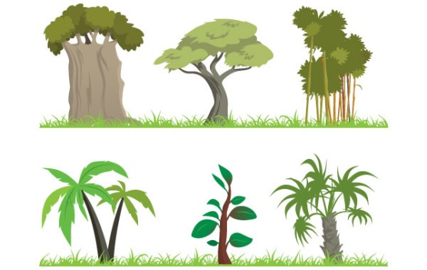

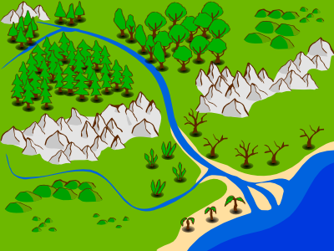
SITE & SITUATION

Slide 2
SITE
SITE deals with a SPOT
Site requires a description of:
Topographic features – may be a few (do they have names e.g valley)
Height ASL – usually a range e.g. 10 to 25 metres asl
Slope – a descriptive term e.g. gentle or undulating
Soil – if it’s possible to determine e.g. alluvial or sand
Vegetation – if its possible to determine, including type and variety of species and density. e.g. medium scrub

Slide 3
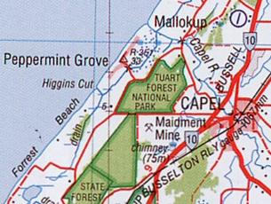
SITE
Natural features of a landscape e.g. rivers, topography, natural vegetation
Site refers to the physical features of the landscape upon which a settlement is built
* Peppermint Grove is located along Forrest Beach approximately 100 metres West of Tuart Forest.
* Peppermint Grove is sited on flat land between 2 and 10 metres.

Slide 4

SITUATION – Where is it?

Slide 5
SITUATION
Where is a place with respect to other places?
The following features are elements of a settlement’s situation:
Latitude and Longitude
Distance and direction to other settlements of similar and greater size
Distance and direction to other key cultural features such as a major highway, junction, or railway line

Slide 6
What does Direction mean?
Direction helps to determine the relative location of features
Cardinal Points – North, South, East, West
Intermediate Points – NE, NW, SE, SW
16 Point Compass – see next slide
Never
Eat
Soggy
Weetbix
BE CAREFUL….
Am I going to OR from?

Slide 7
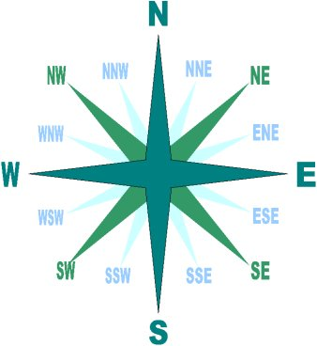

Slide 8
Example – Situation of Dunsborough
Dunsborough is situated 20 kilometres WNW of Busselton located on the Caves Road
Dunsborough is located or situated at Latitude 33° 36' S and Longitude 115° 06' E

Slide 9
Now you must apply these concepts to your case study area…
Focus Research Area 1 (FRA1): Select a case study and investigate this area. Include information such as site and situation, a map, current and past land use information.

